Slide 1
CSC 112: Computer Operating Systems Lecture 5 Scheduling Exercises Solution
Department of Computer Science,
Hofstra University
Acknowledgement: Lecture slides based on UC Berkeley CS 162: Operating Systems and System Programming

Slide 2
Predicting Burst Time
Use exponential averaging τ_{n} = αt_{n-1}+(1-α)τ_{n-1} to predict the next burst time. Assume initial estimate τ₀ = 10, and the actual burst times of the first four processes t₀, t₁, t₂, t₃ are 4, 8, 6 and 7, respectively. Given α = 0.5. Compute the predicted burst times τ₁, τ₂, τ₃, τ_{4.}

Slide 3
Predicting Burst Time ANS
Use exponential averaging τ_{n} = αt_{n-1}+(1-α)τ_{n-1} to predict the next burst time. Assume initial estimate τ₀ = 10, and the actual burst times of the first four processes t₀, t₁, t₂, t₃ are 4, 8, 6 and 7, respectively. Given α = 0.5. Compute the predicted burst times τ₁, τ₂, τ₃, τ_{4.} (It is best if you can bring a calculator. But if you do not have one, just writing out the following formulas is OK.)
τ₁ = 0.5 x 4 + 0.5 x 10 = 7
τ₂ = 0.5 x 8 + 0.5 x 7 = 7.5
τ₃ = 0.5 x 6 + 0.5 x 7.5 = 6.75
τ₄ = 0.5 x 7 + 0.5 x 6.75 = 6.875

Slide 4
Scheduling
Here is a table of processes and their arrival and execution times.
1) Draw the Gantt chart under 4 policies: First Come First Serve (FCFS), Shortest Job First (SJF), Shortest-Remaining-Time-First (SRTF), Round-Robin (RR) with time quantum = 1. Assume that context switch overhead is 0. For RR, assume that an arriving process is scheduled to run at the beginning of its arrival time, i.e., it is added to the head of the queue upon arrival.
2) Compute the finish times and response times for all 5 processes, and the average response time. (If the division is hard, write a fraction like 28/5 instead of 5.6)

Slide 5
Scheduling I
PID | Arriv. time | Exec Time | FCFS Finish Time | FCFS Response Time | SJF Finish Time | SJF Response Time | SRTF Finish Time | SRTF Response Time | RR Finish Time | RR Response Time
1 | 0 | 2
2 | 1 | 6
3 | 4 | 2
 |  | Average Turnaround |  | Avg RT |  | Avg RT |  | Avg RT |  | Avg RT
FCFS
SJF
SRTF
RR
Time | 0 | 1 | 2 | 3 | 4 | 5 | 6 | 7 | 8 | 9 | 10
Gantt Chart
Notes:
So, the average of 2, 7, 5, 6, and 8 is 5.6.
The average of the numbers 2, 7, 5, 9, and 4 is 5.4.
The average of the numbers 2, 8, 1, 9, and 4 is 4.8.
The average of the numbers 3, 12, 1, 9, and 7 is 6.4.

Slide 6
Scheduling I ANS
PID | Arriv. time | Exec Time | FCFS Finish Time | FCFS Response Time | SJF Finish Time | SJF Response Time | SRTF Finish Time | SRTF Response Time | RR Finish Time | RR Response Time
1 | 0 | 2 | 2 | 2 | 2 | 2 | 2 | 2 | 3 | 3
2 | 1 | 6 | 8 | 7 | 8 | 7 | 10 | 9 | 10 | 9
3 | 4 | 2 | 10 | 6 | 10 | 6 | 6 | 2 | 7 | 3
 |  | Average Turnaround |  | Avg RT 5.6 |  | Avg RT 5.6 |  | Avg RT 4.3 |  | Avg RT 5
FCFS | 1 | 1 | 2 | 2 | 2 | 2 | 2 | 2 | 3 | 3
SJF | 1 | 1 | 2 | 2 | 2 | 2 | 2 | 2 | 3 | 3
SRTF | 1 | 1 | 2 | 2 | 3 | 3 | 2 | 2 | 2 | 2
RR | 1 | 2 | 1 | 2 | 3 | 2 | 3 | 2 | 2 | 2
Time | 0 | 1 | 2 | 3 | 4 | 5 | 6 | 7 | 8 | 9 | 10
Gantt Chart
P2 arrival
P1 arrival
P3 arrival
Notes:
So, the average of 2, 7, 5, 6, and 8 is 5.6.
The average of the numbers 2, 7, 5, 9, and 4 is 5.4.
The average of the numbers 2, 8, 1, 9, and 4 is 4.8.
The average of the numbers 3, 12, 1, 9, and 7 is 6.4.

Slide 7
Scheduling II
PID | Arriv. time | Exec Time | FCFS Finish Time | FCFS Response Time | SJF Finish Time | SJF Response Time | SRTF Finish Time | SRTF Response Time | RR Finish Time | RR Response Time
1 | 0 | 3
2 | 1 | 5
3 | 3 | 2
4 | 9 | 2
 |  | Average Turnaround |  | Avg RT |  | Avg RT |  | Avg RT |  | Avg RT
FCFS
SJF
SRTF
RR
Time | 0 | 1 | 2 | 3 | 4 | 5 | 6 | 7 | 8 | 9 | 10 | 11 | 12
Gantt Chart
Notes:
So, the average of 2, 7, 5, 6, and 8 is 5.6.
The average of the numbers 2, 7, 5, 9, and 4 is 5.4.
The average of the numbers 2, 8, 1, 9, and 4 is 4.8.
The average of the numbers 3, 12, 1, 9, and 7 is 6.4.

Slide 8
Scheduling II ANS
PID | Arriv. time | Exec Time | FCFS Finish Time | FCFS Response Time | SJF Finish Time | SJF Response Time | SRTF Finish Time | SRTF Response Time | RR Finish Time | RR Response Time
1 | 0 | 3 | 3 | 3 | 3 | 3 | 3 | 3 | 6 | 6
2 | 1 | 5 | 8 | 7 | 10 | 9 | 10 | 9 | 11 | 10
3 | 3 | 2 | 10 | 7 | 5 | 2 | 5 | 2 | 7 | 4
4 | 9 | 2 | 12 | 3 | 12 | 3 | 12 | 3 | 12 | 3
 |  | Average Turnaround |  | Avg RT 5 |  | Avg RT 4.25 |  | Avg RT 4.25 |  | Avg RT 5.75
FCFS | 1 | 1 | 1 | 2 | 2 | 2 | 2 | 2 | 3 | 3 | 4 | 4
SJF | 1 | 1 | 1 | 3 | 3 | 2 | 2 | 2 | 2 | 2 | 4 | 4
SRTF | 1 | 1 | 1 | 3 | 3 | 2 | 2 | 2 | 2 | 2 | 4 | 4
RR | 1 | 2 | 1 | 3 | 2 | 1 | 3 | 2 | 2 | 4 | 2 | 4
Time | 0 | 1 | 2 | 3 | 4 | 5 | 6 | 7 | 8 | 9 | 10 | 11 | 12
Gantt Chart
P2 arrival
P1 arrival
P3 arrival
P4 arrival
Notes:
So, the average of 2, 7, 5, 6, and 8 is 5.6.
The average of the numbers 2, 7, 5, 9, and 4 is 5.4.
The average of the numbers 2, 8, 1, 9, and 4 is 4.8.
The average of the numbers 3, 12, 1, 9, and 7 is 6.4.

Slide 9
Scheduling II ANS
RR scheduling explanations:
Time 1: P2 arrives, and it runs immediately based on our assumption that an arriving process is added to the head of the queue upon arrival.
Time 3: P3 arrives, and it runs immediately.
Time 4: P2 runs since it is next in ready queue based on the cyclic pattern of “12, 12”.
Time 6: P3 runs based on the cyclic pattern of “321, 321”.
Time 9: P4 arrives, and it runs immediately.
FCFS | 1 | 1 | 1 | 2 | 2 | 2 | 2 | 2 | 3 | 3 | 4 | 4
SJF | 1 | 1 | 1 | 3 | 3 | 2 | 2 | 2 | 2 | 2 | 4 | 4
SRTF | 1 | 1 | 1 | 3 | 3 | 2 | 2 | 2 | 2 | 2 | 4 | 4
RR | 1 | 2 | 1 | 3 | 2 | 1 | 3 | 2 | 2 | 4 | 2 | 4
Time | 0 | 1 | 2 | 3 | 4 | 5 | 6 | 7 | 8 | 9 | 10 | 11 | 12
Gantt Chart
P2 arrival
P1 arrival
P3 arrival
P4 arrival
Notes:
So, the average of 2, 7, 5, 6, and 8 is 5.6.
The average of the numbers 2, 7, 5, 9, and 4 is 5.4.
The average of the numbers 2, 8, 1, 9, and 4 is 4.8.
The average of the numbers 3, 12, 1, 9, and 7 is 6.4.

Slide 10
Scheduling III
Consider the set of 3 processes whose arrival time and CPU burst times are given below. If the CPU scheduling policy is FCFS, draw the Gantt chart and calculate the average response time.
PID | Arriv. time | Exec Time | FCFS Finish Time | FCFS Response Time
1 | 0 | 2
2 | 3 | 1
3 | 5 | 6
 |  | Average Turnaround |  | Avg RT

Slide 11
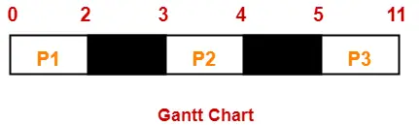
Scheduling III ANS
PID | Arriv. time | Exec Time | FCFS Finish Time | FCFS Response Time
1 | 0 | 2 | 2 | 2
2 | 3 | 1 | 4 | 1
3 | 5 | 6 | 11 | 6
 |  | Average Turnaround |  | Avg RT 3
P2 arrival
P1 arrival
P3 arrival
Gantt Chart
Notes:
So, the average of 2, 7, 5, 6, and 8 is 5.6.
The average of the numbers 2, 7, 5, 9, and 4 is 5.4.
The average of the numbers 2, 8, 1, 9, and 4 is 4.8.
The average of the numbers 3, 12, 1, 9, and 7 is 6.4.

Slide 12
Scheduling with Bursts I
Consider the set of 3 processes whose arrival time and CPU/IO burst times are given below. If the CPU scheduling policy is Shortest Remaining Time First (SRTF), draw the Gantt chart and calculate the average response time. (Note: consider the overlap of computation and IO busts of different processes)
PID | Arriv. time | IO Burst | CPU Burst | IO Burst
1 | 0 | 2 | 7 | 1
2 | 0 | 4 | 14 | 2
3 | 0 | 6 | 21 | 3
 |  |  |  | Avg RT

Slide 13
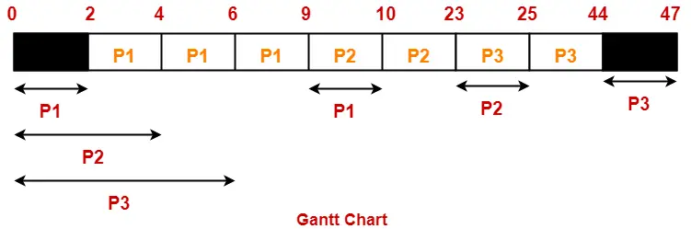
Scheduling with Bursts I ANS
PID | Arriv. time | IO Burst | CPU Burst | IO Burst | Finish Time | Resp. Time
1 | 0 | 2 | 7 | 1 | 10 | 10
2 | 0 | 4 | 14 | 2 | 25 | 25
3 | 0 | 6 | 21 | 3 | 47 | 47
 |  |  |  |  | Avg RT | 27.3
IO
IO
IO
IO
P1, P2, P3 arrival
IO
IO

Slide 14
Scheduling with Bursts II
Consider the set of 3 processes whose arrival time and CPU/IO burst times are given below. If the CPU scheduling policy is Fixed-Priority Scheduling (larger number denotes higher priority), draw the Gantt chart and calculate the average response time.
PID | Arriv. time | Priority | CPU Burst | IO Burst | CPU Burst
1 | 0 | 2 | 1 | 5 | 3
2 | 2 | 1 | 3 | 3 | 1
3 | 3 | 3 | 2 | 3 | 1
 |  |  | Avg RT |  | Avg RT

Slide 15
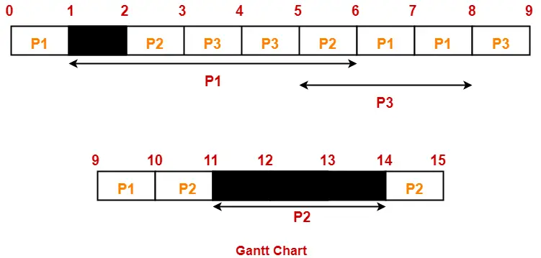
Scheduling with Bursts ANS
PID | Arriv. time | Priority | CPU Burst | IO Burst | CPU Burst | Finish Time | Resp. Time
1 | 0 | 2 | 1 | 5 | 3 | 10 | 10
2 | 2 | 1 | 3 | 3 | 1 | 15 | 13
3 | 3 | 3 | 2 | 3 | 1 | 9 | 6
 |  |  |  |  |  | Avg RT | 9.67
For fixed-priority scheduling, draw the Gantt chart starting from highest priority process and go down to the lowest priority (first P3, then P1, then P2). Schedule CPU bursts of lower priority processes in the remaining time slots that are left over by higher priority processes.
IO
P1 arrival
P2 arrival
IO
P3 arrival
IO

